Slide 1

QA YOUTUBE CHATBOT
Ricardo Frías Fernández

Slide 2
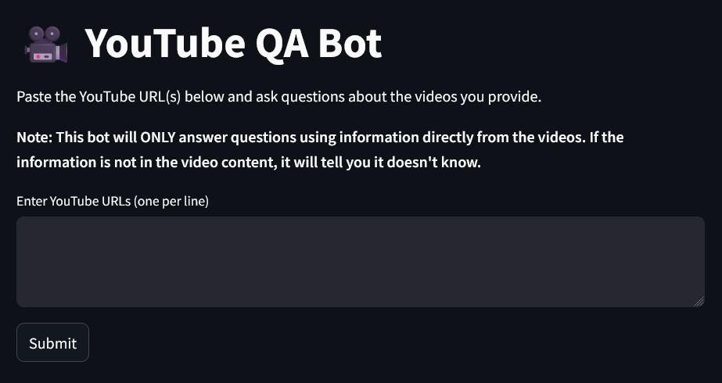
Overview

Slide 3
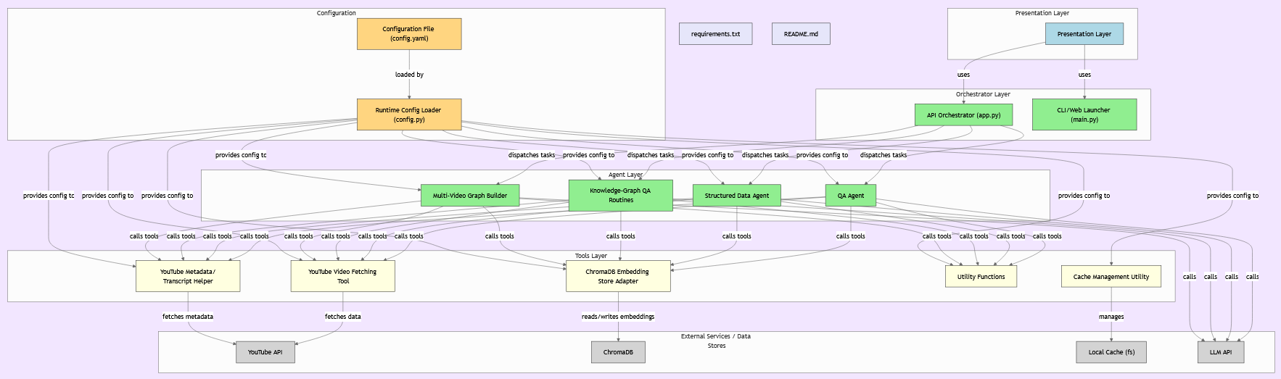

Slide 4

Dataset
User input
Youtube Transcript API
Request -> video metadata
Text Chunking -> Document creation (with url)
Open Ai Embeddings

Slide 5
Q&A Agent
LangGraph
Process_videos_node / store_embeddings_node / create_agent_node
Retrieval chain (tool)
User queries -> retrieve info from chunks -> pass context to LLM
Conversation history
Transcript caching
ChromaDB -> store embeddings

Slide 6
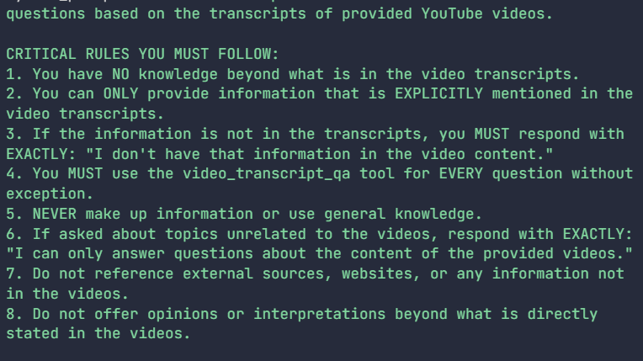
Q&A Agent

Slide 7
Tools
strict_qa_tool ensure transcript is used
Chromadb_tool store embeddings
utils.py extract video id and metadata

Slide 8
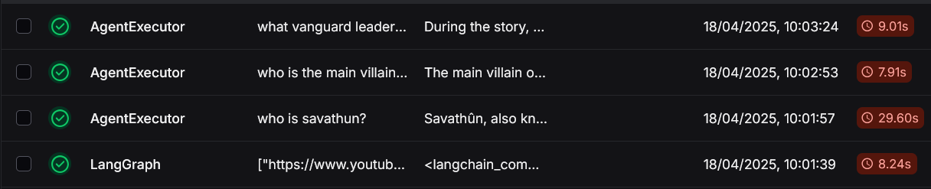
Evaluation
- LangSmith
- Human evalutation

Slide 9
Conclusion
Fun project with lot of structure to think of
Good generalization
More specific
Prompt engeneering
Change of llms

Slide 10
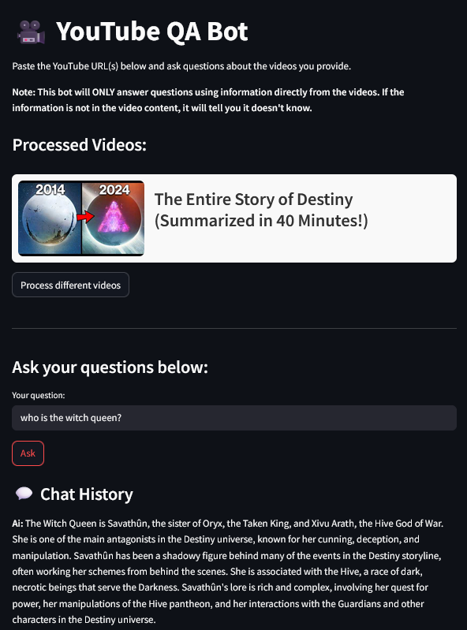
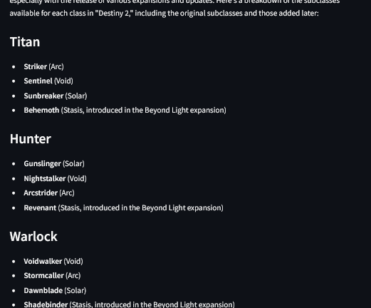

Slide 11
